Slide 1
Aprendiendo Xamarin!
22.02.2018
Más allá del desarrollo
JAVIER SUÁREZ RUIZ
XAMARIN TEAM LEAD

Slide 2
Introducción a Xamarin.Forms
¿Cómo desarrollamos en Xamarin?
Próximas novedades
Tendencias
Preguntas y Respuestas

Slide 3

Javier Suárez
DEVELOPER
Visual Studio Technologies & Windows Platform Development MVP
Xamarin MVP
Software Developer at Plain Concepts
@jsuarezruiz

Slide 4
Más allá del desarrollo

Slide 5
Caeracterísticas esenciales para el éxito en mobile
Aplicaciones nativas
Build, test, distribuir, aprender
Nube inteligente

Slide 6

COSAS QUE PASAN… ¿CIERTO?

Slide 7

EL RETO
Fragmentación
Complejidad de Apps
Ciclos ágiles
Expectación alta usuarios
Notes:
Well there are several challenges that we must overcome as mobile developers including….

Slide 8


EN TELÉFONOS, LA CALIDAD CUESTA
+5 Versiones del sistema
22 Dispositivos
20 Idiomas
35 Localizaciones
6 Tamaños de pantalla
9 Versiones del sistema
6 Configuraciones de pantalla
27 Tamaños de pantalla
39 Idiomas
57 Localizaciones
+15 Fabricantes
Más de 19,000 dispositivos distintos
8
Notes:
First let’s take a look at the shear number of configurations there are between iOS and Android. As iOS progresses this number is only set to increase, and on Android it is already a HUGE number of configurations to even think about testing.
iOS: 7, 7.1, 8, 8.1, 8.2

Slide 9
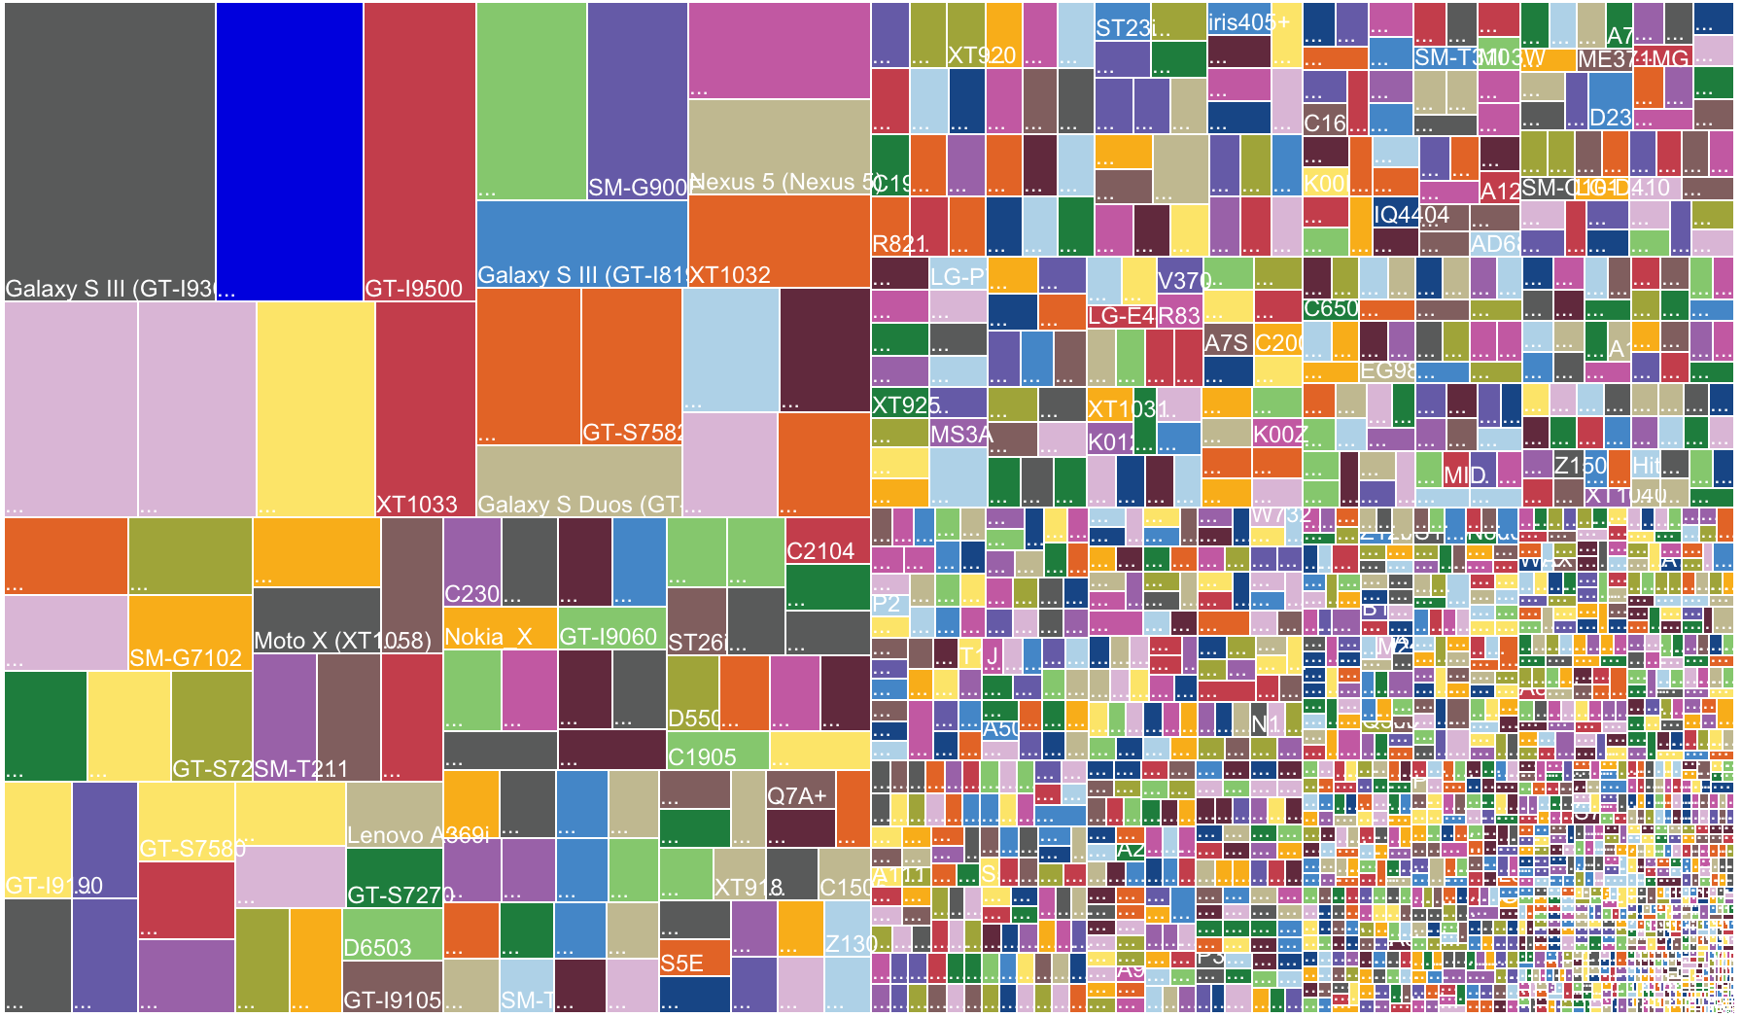

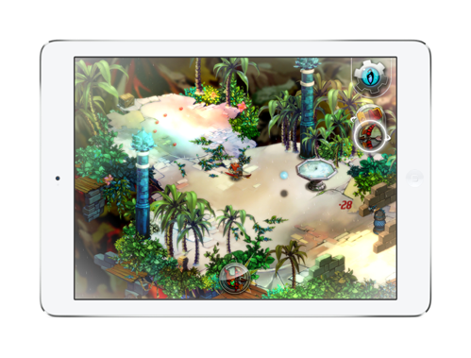
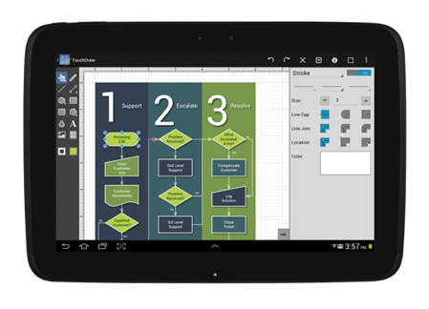
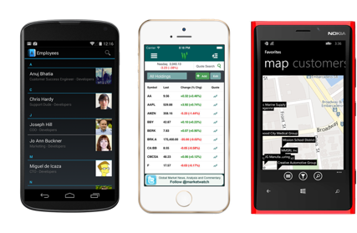
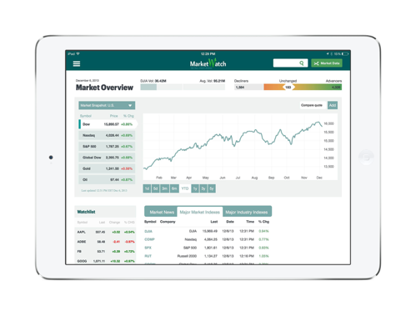
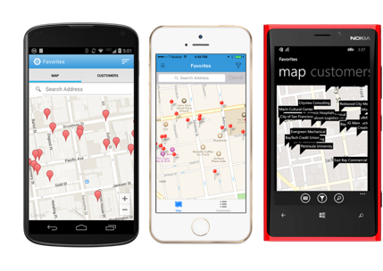
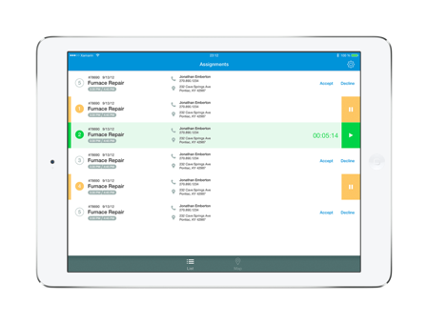
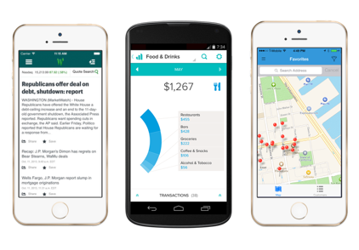
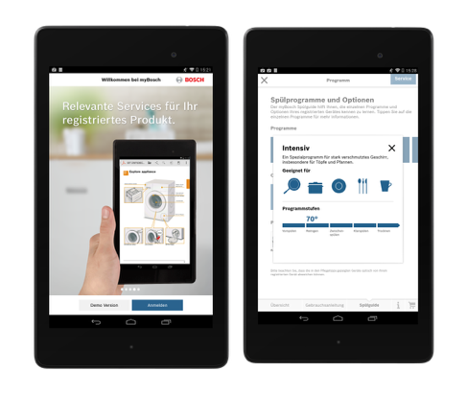
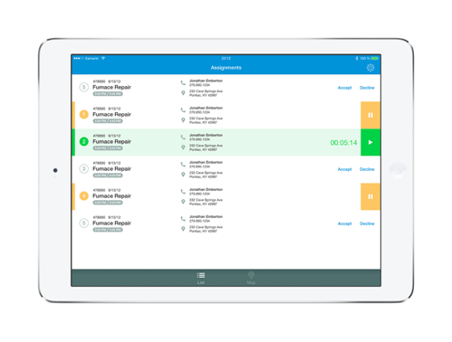
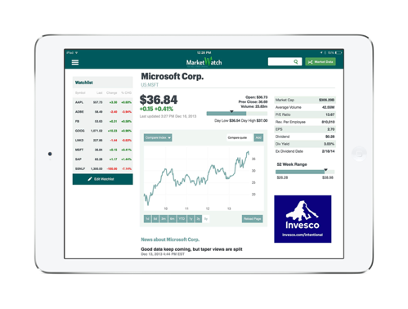
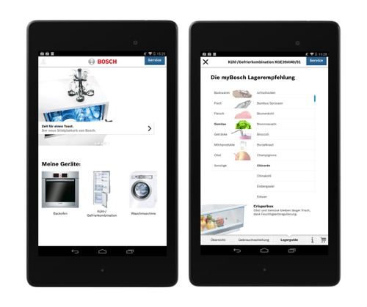
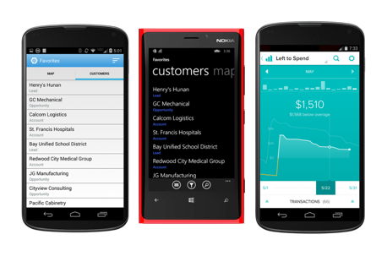
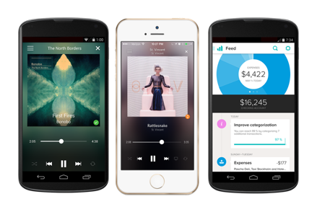
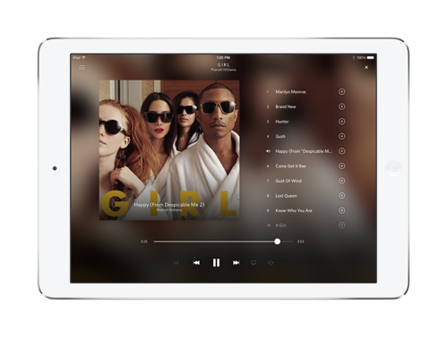
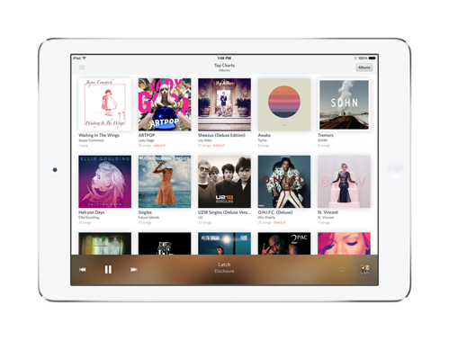
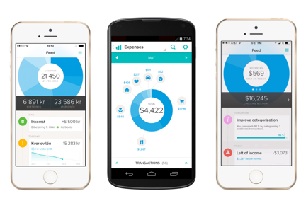
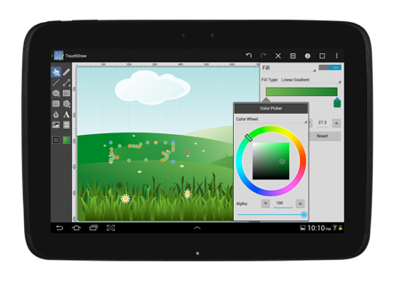
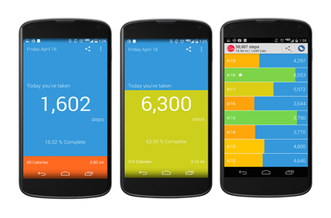
Notes:
OpenSignal is a global app that publishes an annual report on Android device fragmentation based on the distinct Android device types that download their app. This is their August 2014 data, with an astonishing 19,000 device types using their app, up by 60% from just last year.
Different device operating systems, form factors, screen sizes, resolutions, chip sets, and manufacturer modifications make it difficult to know that your app will work well on all devices

Slide 10


Notes:
Looking at just a few of the screen sizes of Samsung devices you couldn’t even fit all of them on the screen, so how do you handle this problem?

Slide 11
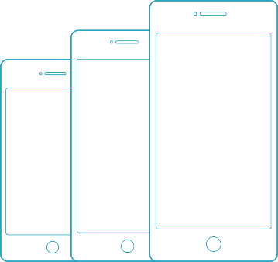

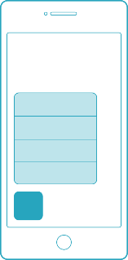
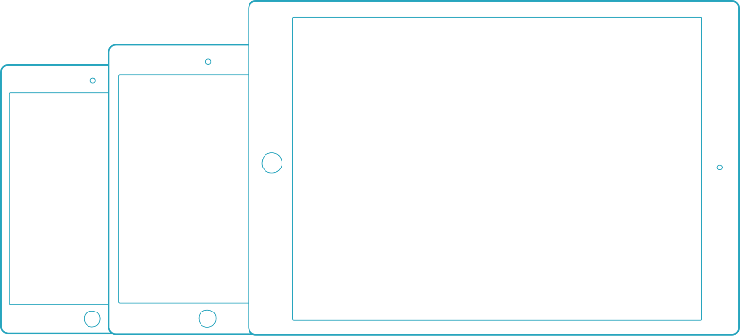
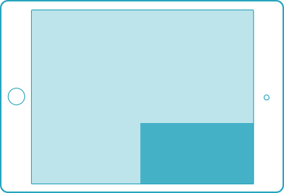
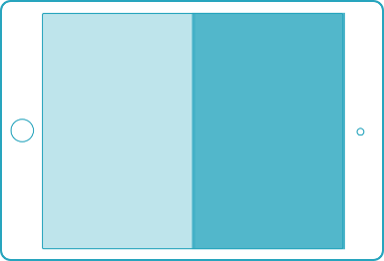
DIVERSIFICACIÓN EN IOS
3D Touch
Apple pencil
iPhones
iPod touch
iPad Pro
iPhone 6s
iPads
Multi Tasking
Solo en algunos iPads
Factores de forma
Características iOS 9

Slide 12
Xamarin Profiler

Slide 13
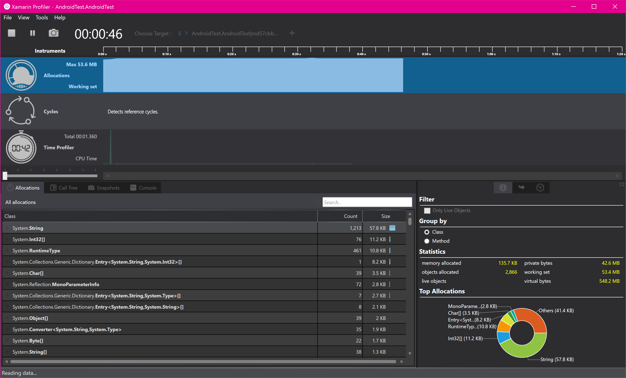
Xamarin Profiler
Análisis de consumo de CPU, memoria, llamadas, etc.

Slide 14
Xamarin Inspector

Slide 15
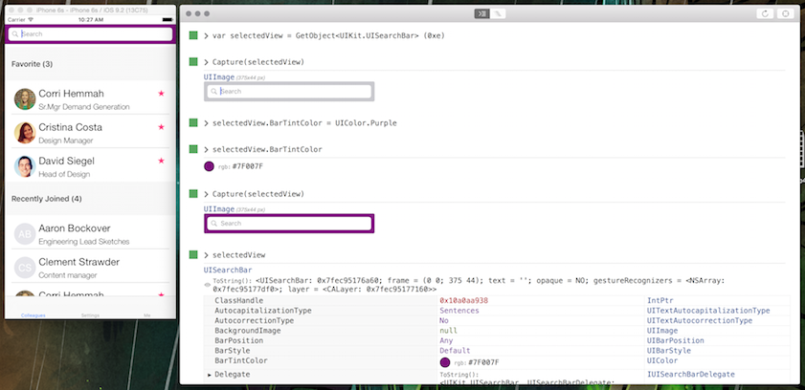
Xamarin Inspector
Permite inspeccionar el árbol visual de nuestra App, modificar elementos y ejecutar pequeñas expresiones en C# sin necesidad de detener la App.

Slide 16
Probando Xamarin Inspector

Slide 17

Mercado dispositivos USA
288
Deberíamos tener 134 dispositivos para cubrir al menos el 75% del Mercado de USA
Number of Devices
134
45
13
0
Market Share
25%
50%
75%
90%
Notes:
To hit 75% of the US market you would need over 130 devices and nearly 300 devices to hit 90% of what your users are using today. That is unrealistic to even think about purchasing.

Slide 18
¿Cómo testeamos?
Test más complejos
Test automáticos de UI permiten asegurar:
Arranque
Apariencia
Comportamiento
En distintos dispositivos
Beta Testing
Test automáticos de UI
Test manuales
Iteraciones rápidas
Ciclos prolongados
Unit Testing
Tests simples
Notes:
There are several different ways to test mobile applications.
We can have extensive beta tests with our users, which is good for hands on, but hard to get feedback.
We can spend hours upon hours manually testing which can help find bugs, but can bog down developers.
Unit testing is essential for our business logic, but only Automated UI Testing can really ensure that as we add new features and fix bugs our UI isn’t impacted before we release.

Slide 19
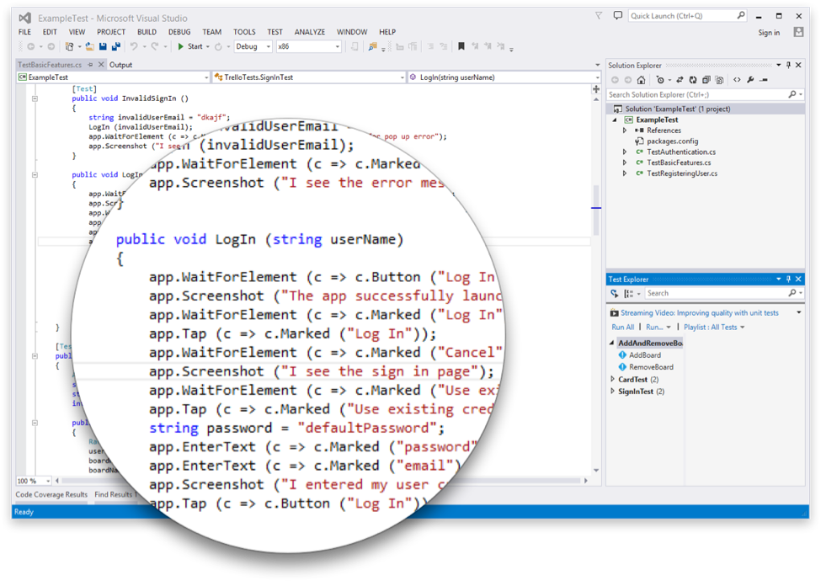
INTRODUCCIÓN A XAMARIN.UITEST
Crear tests automáticos de la interfaz de usuarios en C#
Se pueden corer directamente desde Visual Studio o Xamarin Studio
Se pueden usar simuladores
Funciona con apps: Nativas, Híbridas o Xamarin
Se pueden subir a Test Cloud
Notes:
This is where Xamarin.UITest comes in to help with this shift. Xamarin.UITest is a framework that ties in directly to the Nunit testing framework to write the UI tests. You can even run them directly against a simulator for free to do regression tests on your applications.

Slide 20
Xamarin.UITest

Slide 21

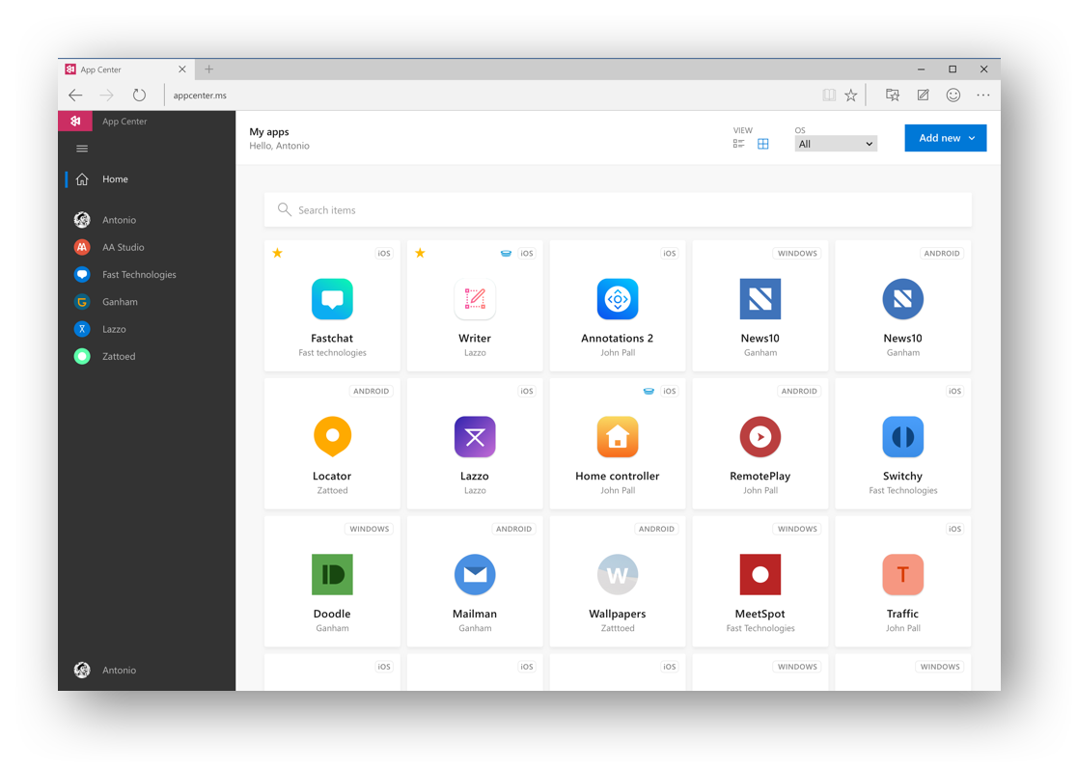
Visual Studio
App Center
appcenter.ms

Slide 22
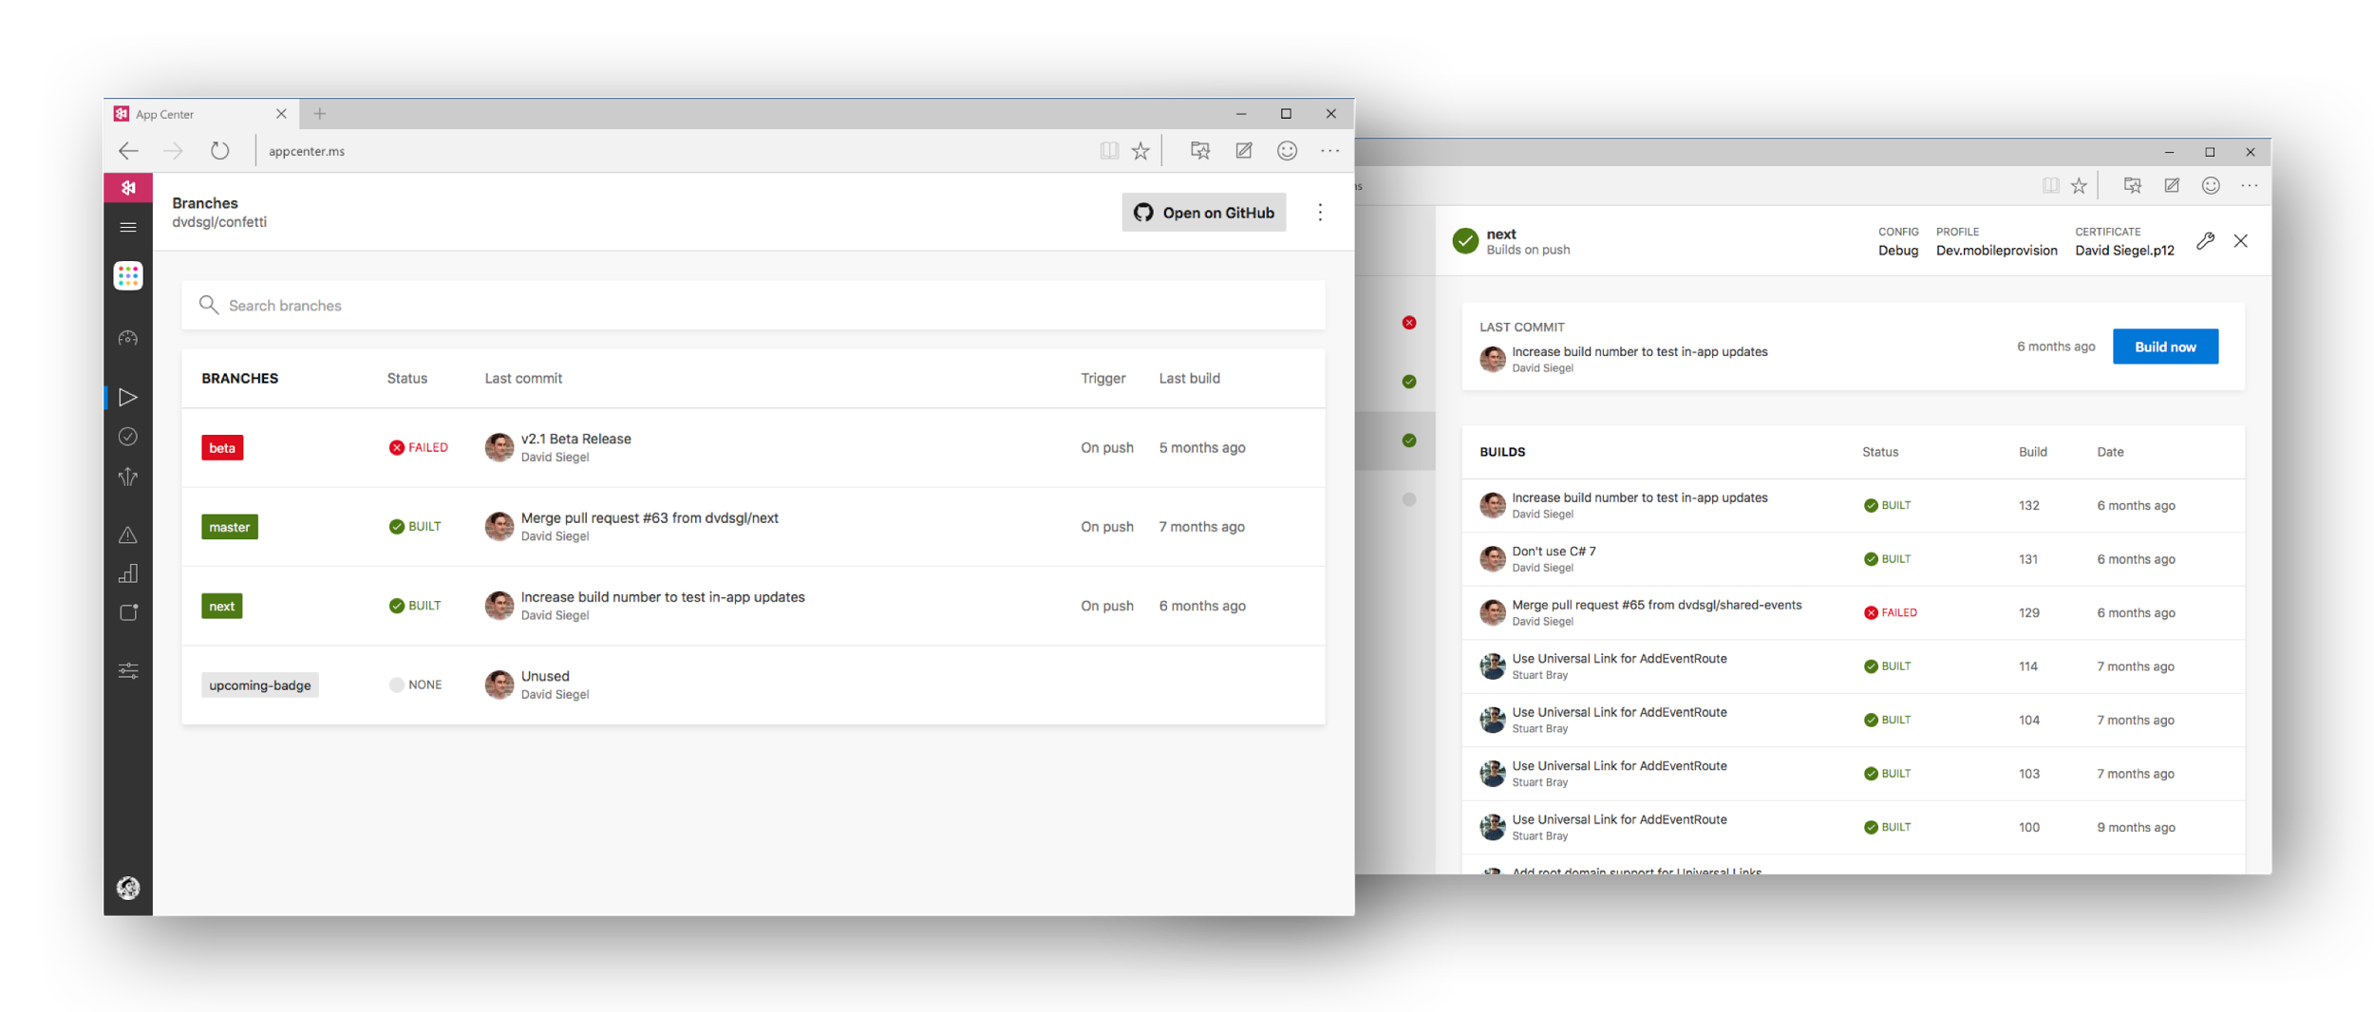






Visual Studio App Center

Slide 23
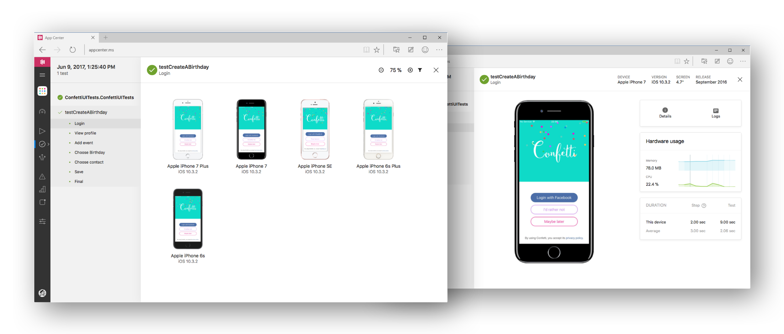


Visual Studio App Center

Slide 24
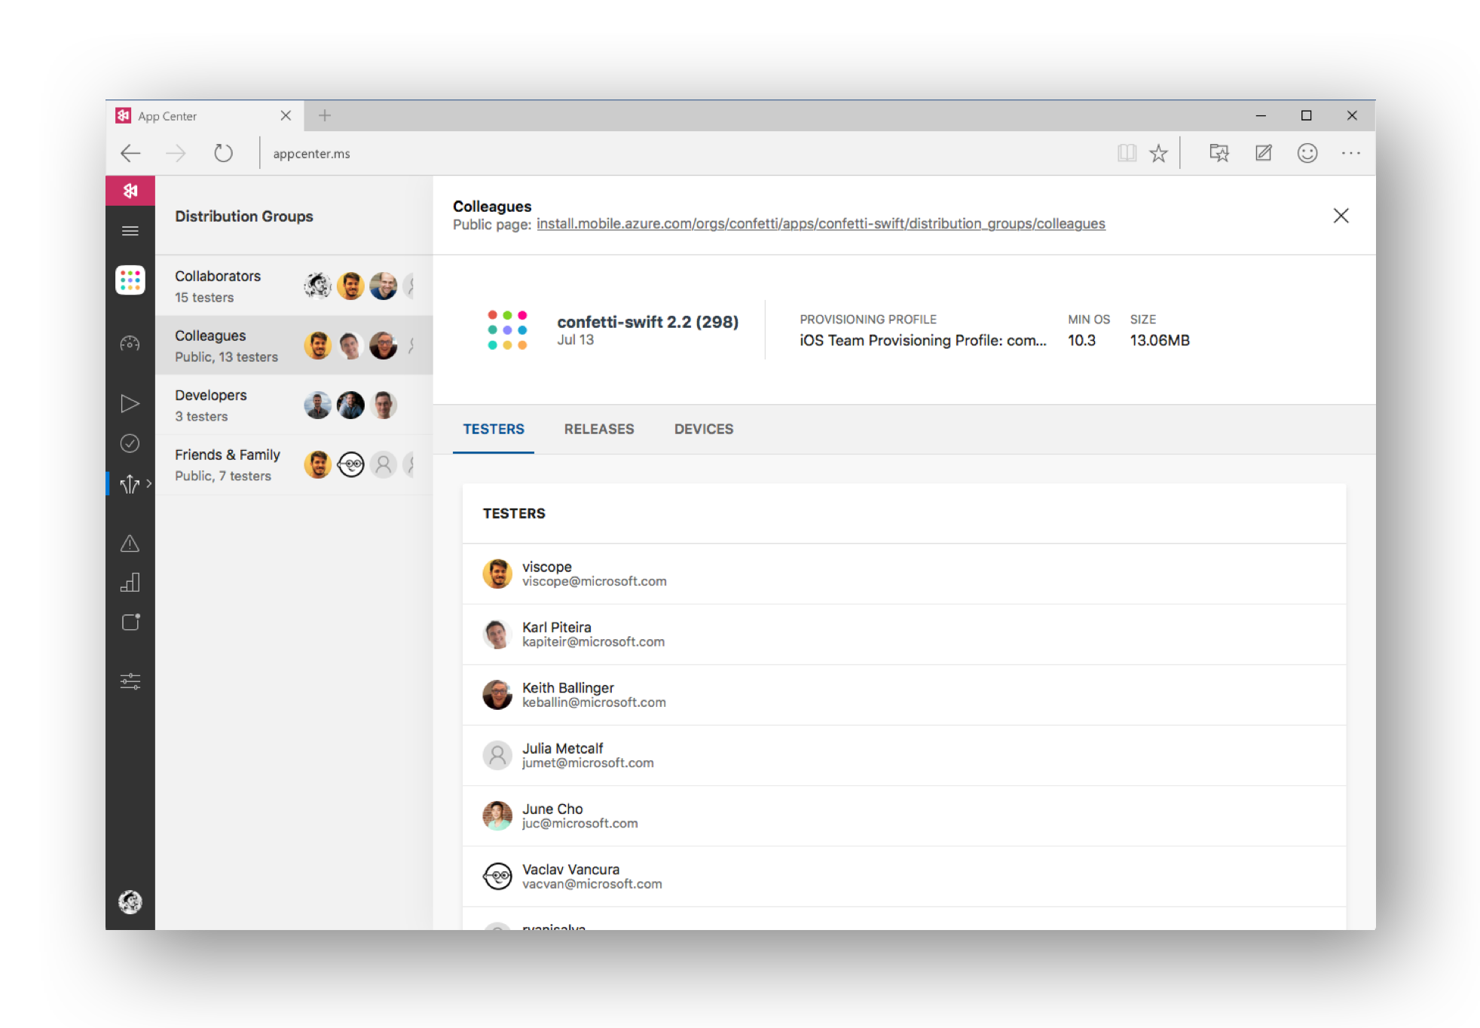

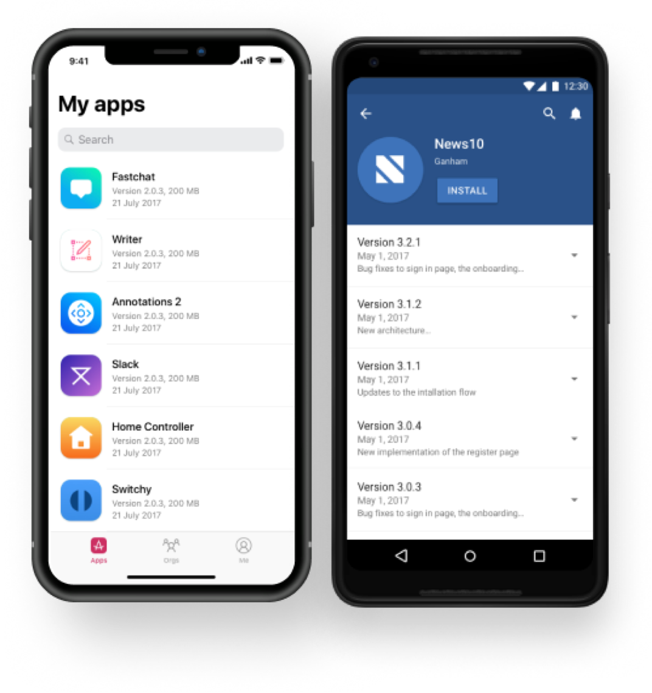

Visual Studio App Center
HockeyApp
iOS, Android, UWP

Slide 25
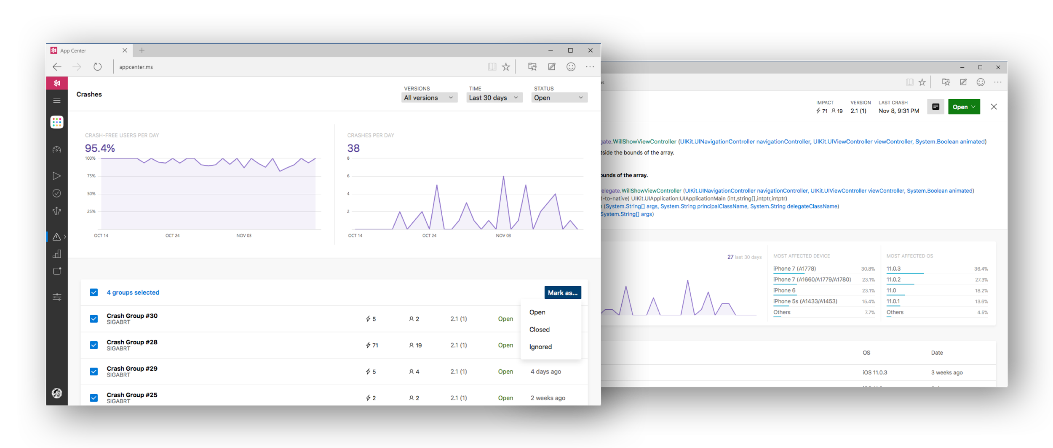

Visual Studio App Center

Slide 26
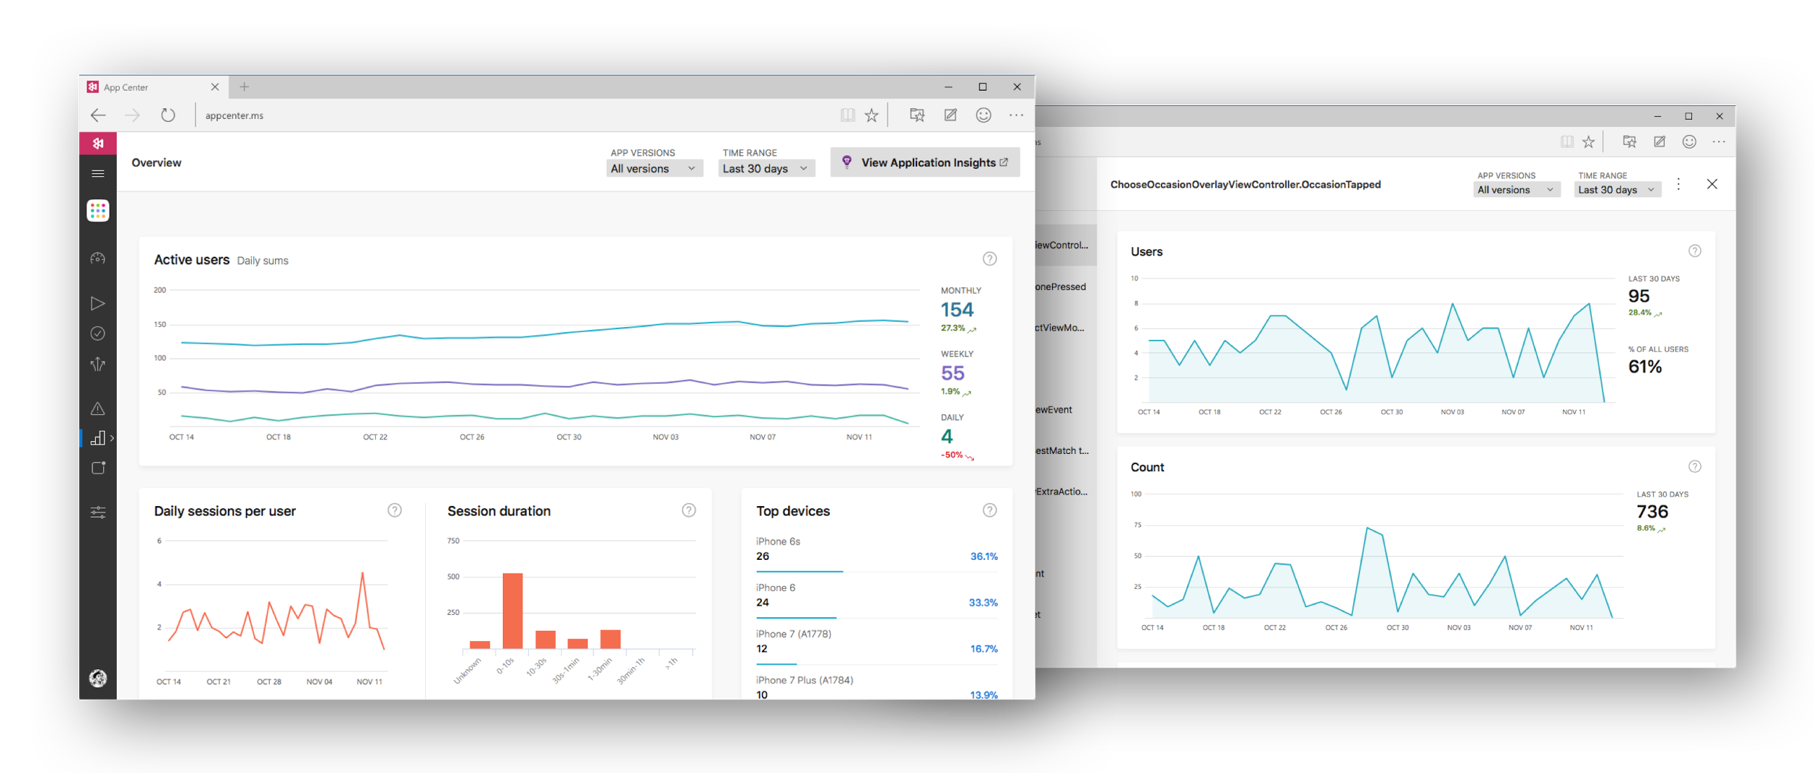
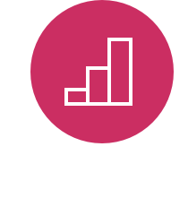
Visual Studio App Center

Slide 27
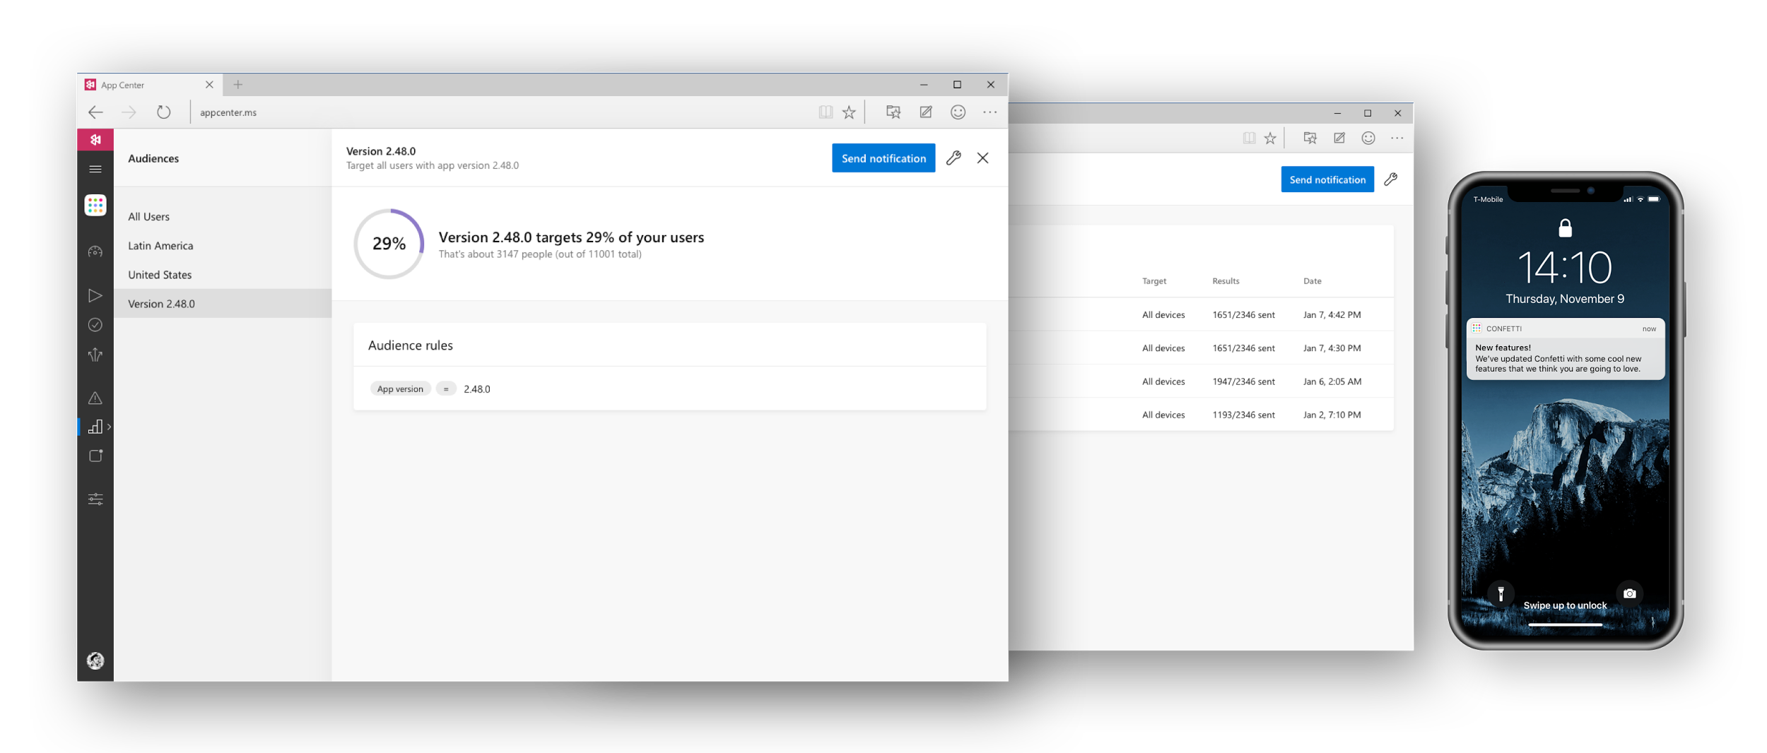

Visual Studio App Center

Slide 28
App Center

Slide 29
¿Preguntas?

Slide 30
¡GRACIAS!
www.plainconcepts.com
@plainconcepts

